Slide 1

Diabetes Health App
Technical Presentation
Sim Yuh Fan
Sahendra Pang
Santi
Tan Xiang Feng
Zhang Zhewei
A0249251E
A0135877N
A0249294R
A0072452L
A0249258R
Notes:
Hi,
This is technical presentation video for our Group.
Our project is Diabetes Health App
The vision of this app is a digital health companion for everyone and everywhere.
As a MVP delivery the specific target is Diabetic Type 2,
Our target customer are:
People that has higher risk of getting diabetic type 2
People that already has diabetic type 2 and want to stay healthy
People that has a concern their diabetic will cause blindness
This app not intended to replace a doctor but more to improve user’s lifestyle and awareness on their own health condition

Slide 2
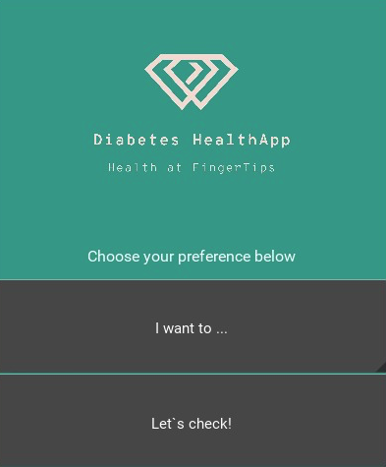
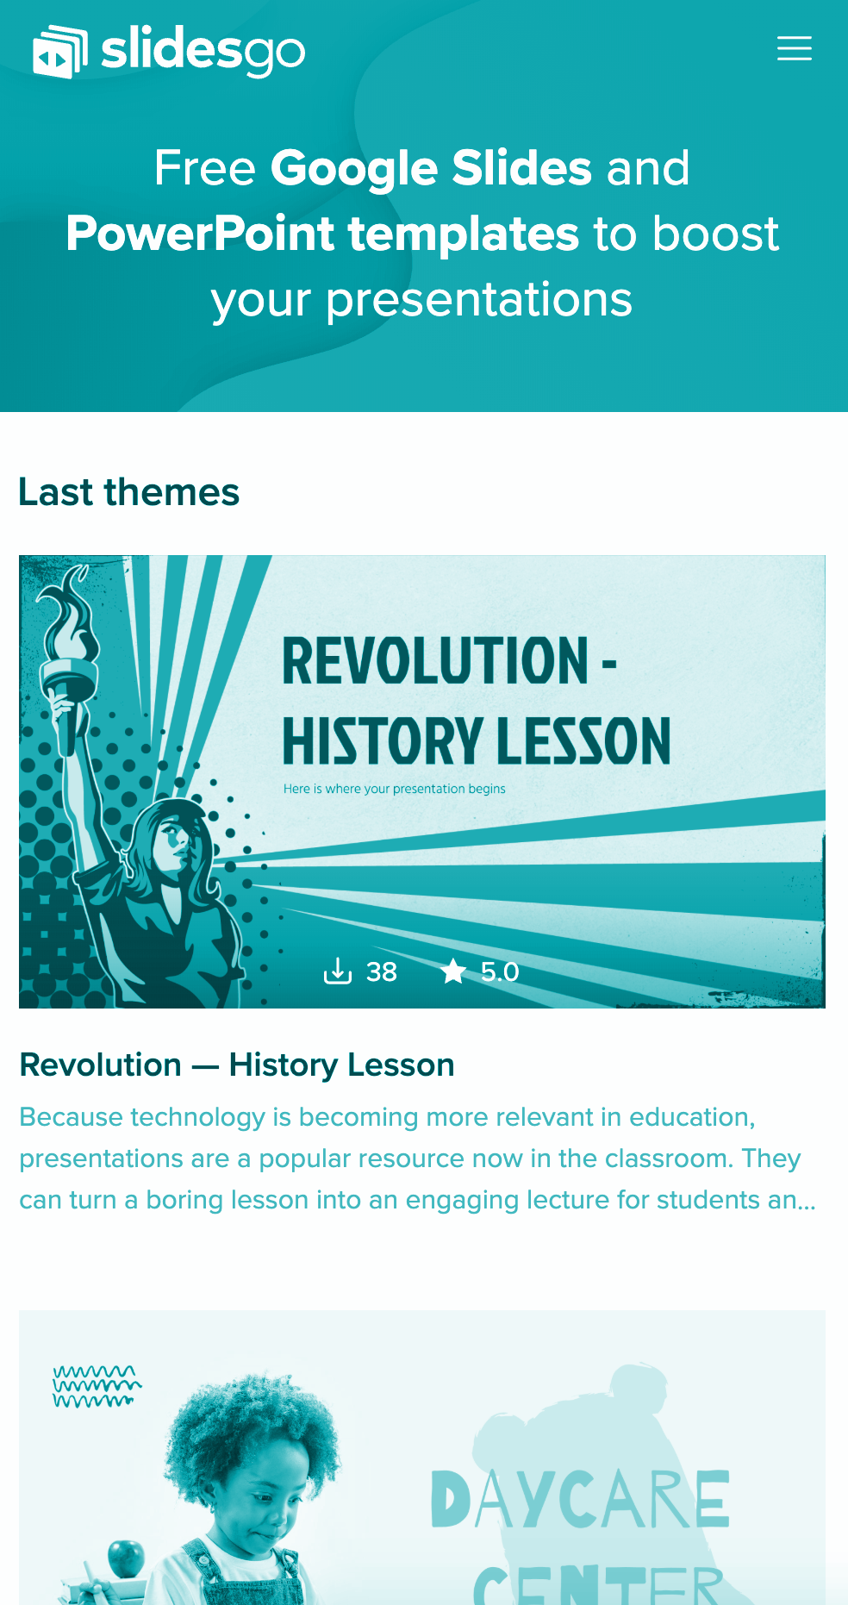
Diabetes Health App
Predicting Risk of Diabetes
Lifestyle Recommender
Detect Diabetic Retinopathy
Notes:
The main feature that we want to introduce are:
Predicting risk of diabetes, this feature we introduce to predict a risk of getting diabetic based on some characteristic features
Lifestyle recommender, this feature will help user to improve their overall health by following healthy diet as well as maintaining healthy physical activity
3. Diabetic Retinopathy detection. this feature is more specific for users with long term diabetic issue.
and they are worry on their eye health, as Diabetic Retinopathy is one of the main side effect of diabetic..

Slide 3
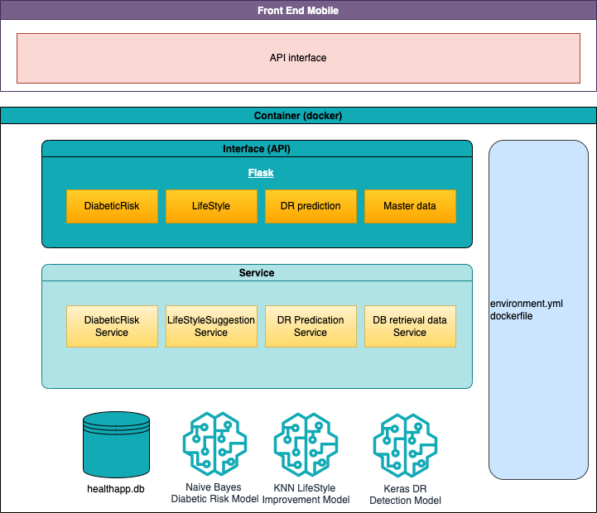

Overall System Arthitecture
Notes:
This is the Overall system Architecture:.
there are two majors components in the Diabeties health app.
android application and AI engine
The android application is build using Kivy Python framework
While the Engine is built with python and deployed in docker container.
There are few components that supported the engine such as:
Flask API services
Scikit-learn & keras as supervised learning components
Sqlite database
Others, we provided User Manual for more detail explanations
The model is deployed with
Pickle File
Hierarchical Data Format

Slide 4
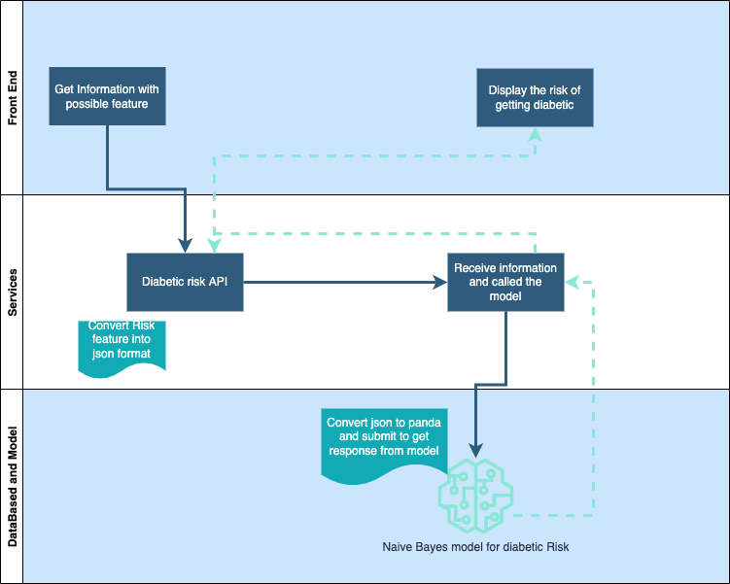
1. Predicting Risk of Diabetes
Notes:
First feature is Predicting Risk of Diabetes.
This feature is meant for user which has no prior knowledge of having diabetic
When choose this menu, user will be asked some questions. we will be elaborate this in the next few slides
Once user submit the app will submit a request with json format to the services.
The service will then convert the json format to panda dataframes and call the diabetic Risk model.
The algorithm being used for this model is Naïve Bayes

Slide 5
1. Predicting Risk of Diabetes – Questionare
Notes:
As mentioned earlier, user will need to answer set of questions as shown here before,
The app send request to the service.
The answer of those questions will actually converted as input parameters into JSON format.

Slide 6
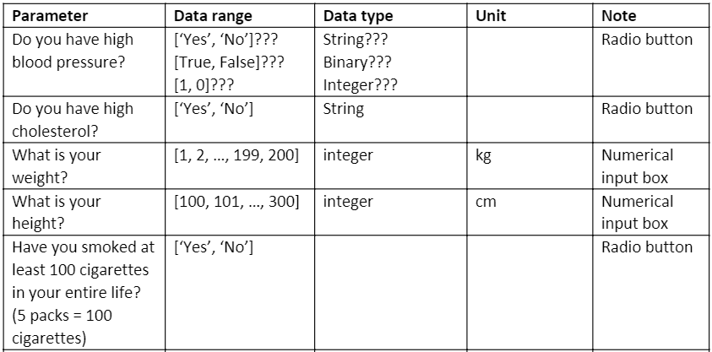
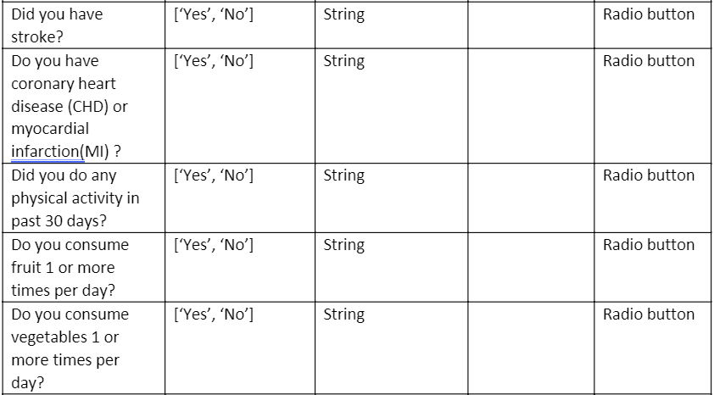
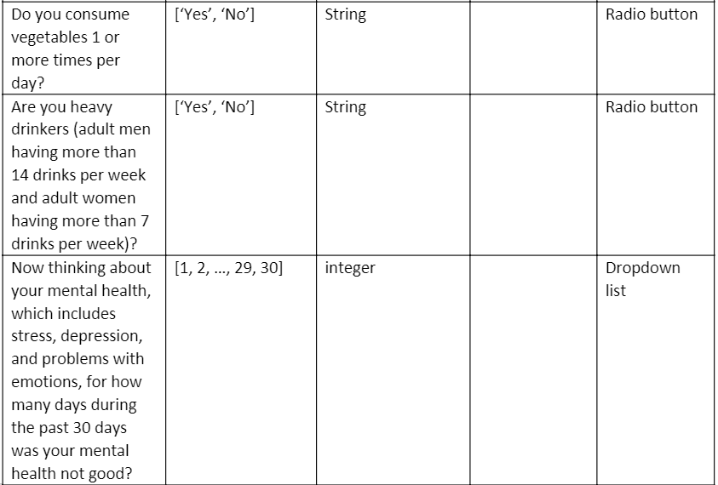
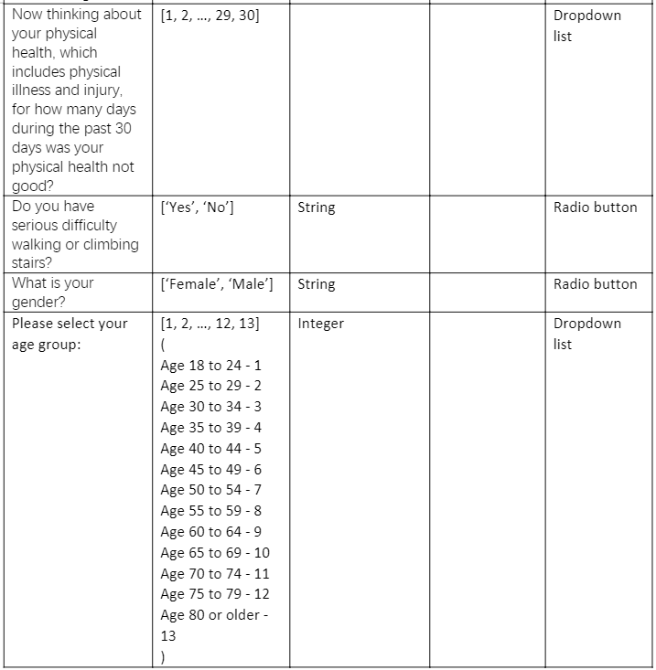
1. Predicting Risk of Diabetes – Input parameters
Notes:
The answer of those questions will actually converted as input parameters into JSON format.

Slide 7
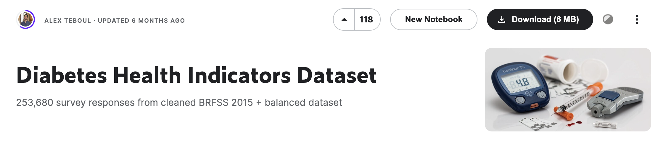
1. Predicting Risk of Diabetes – Dataset
https://www.kaggle.com/datasets/alexteboul/diabetes-health-indicators-dataset
Notes:
The data is obtained from Kaggle, which had been cleaned and categorized.
The raw data is originated from The Behavioral Risk Factor Surveillance System (BRFSS).
The Behavioral Risk Factor Surveillance System (BRFSS) is a health-related telephone survey that is collected annually by the CDC.
Each year, the survey collects responses from over 400,000 Americans on health-related risk behaviors, chronic health conditions, and the use of preventative services. It has been conducted every year since 1984.
For this project, a csv of the dataset available on Kaggle for the year 2015 was used. This original dataset contains responses from 441,455 individuals and has 330 features. These features are either questions directly asked of participants, or calculated variables based on individual participant responses.

Slide 8
1. Predicting Risk of Diabetes – Model
 | TRAINING | VALIDATION
Naïve Bayes | 68% | 69%
Decision Tree | 92% | 65%
KNN | NA | 69%
Random Forest | NA | 45%
Notes:
We have tried various type of algorithm such as, Naïve bayes, Decision tree, KNN and Random Forest.
For the given dataset, we have decided to use Naïve Bayes Model as it is more stable.
smaller gap between the training and test dataset indicates the model Is more stable with less over-fitting.

Slide 9
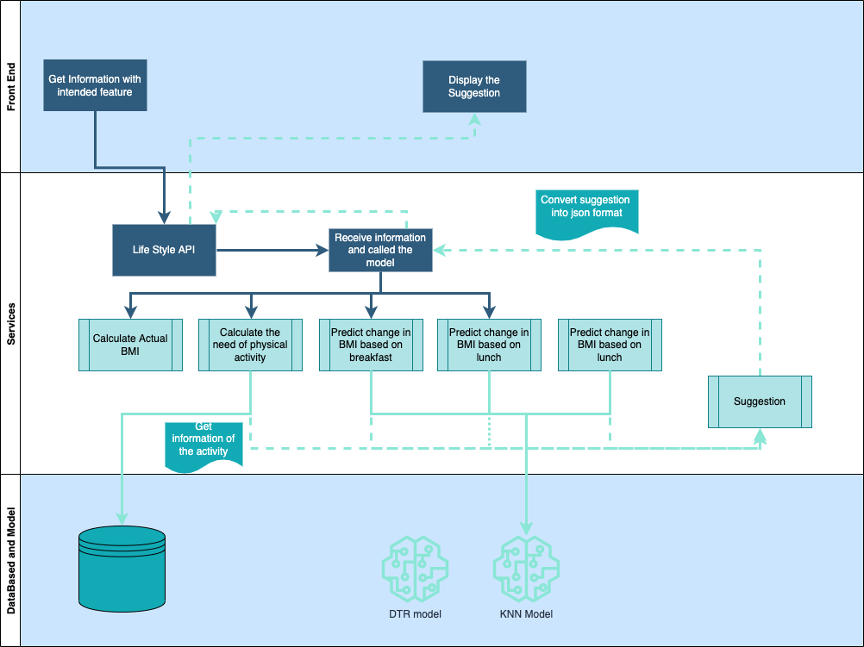
2. Lifestyle Recommender
Notes:
Second feature is Lifestyle Recommender:.
This feature is meant for user who want to improve their daily lifestyle to get healthier
When choose this menu, user will be asked some questions. we will be elaborate this in the next few slides
Once user submit the app will submit a request with json format to the services.
The service will use the information to execute a series of machine reasoning logic:
Based on selection of meal system will use KNN model to determine what is the predicted BMI and if not within healthy BMI system will advice user to get a healthier meal
Based on user BMI and also their physical activity, system will give a suggestion whether user had done enough physical activity or need to add the frequency, add the duration or even change the activity type.

Slide 10
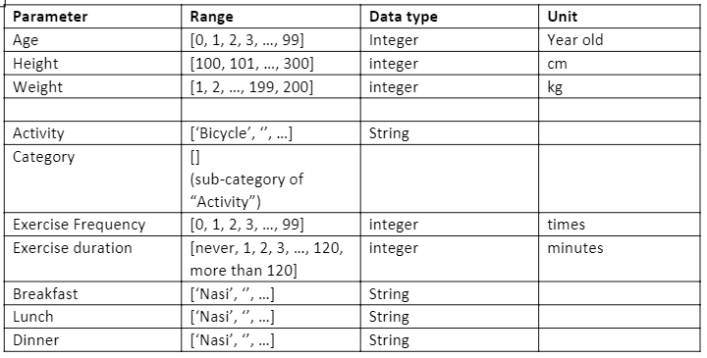
2. Lifestyle Recommender - Questionnaire
Notes:
LifeStyle Improvement recommender Questionnaire:
Age
Weight (in Kilogram)
Heights (in centimeter)
Physical Activity
Activity level
Exercise frequency every week
Duration of each exercise
The breakfast, lunch, dinner taken on the particular day

Slide 11
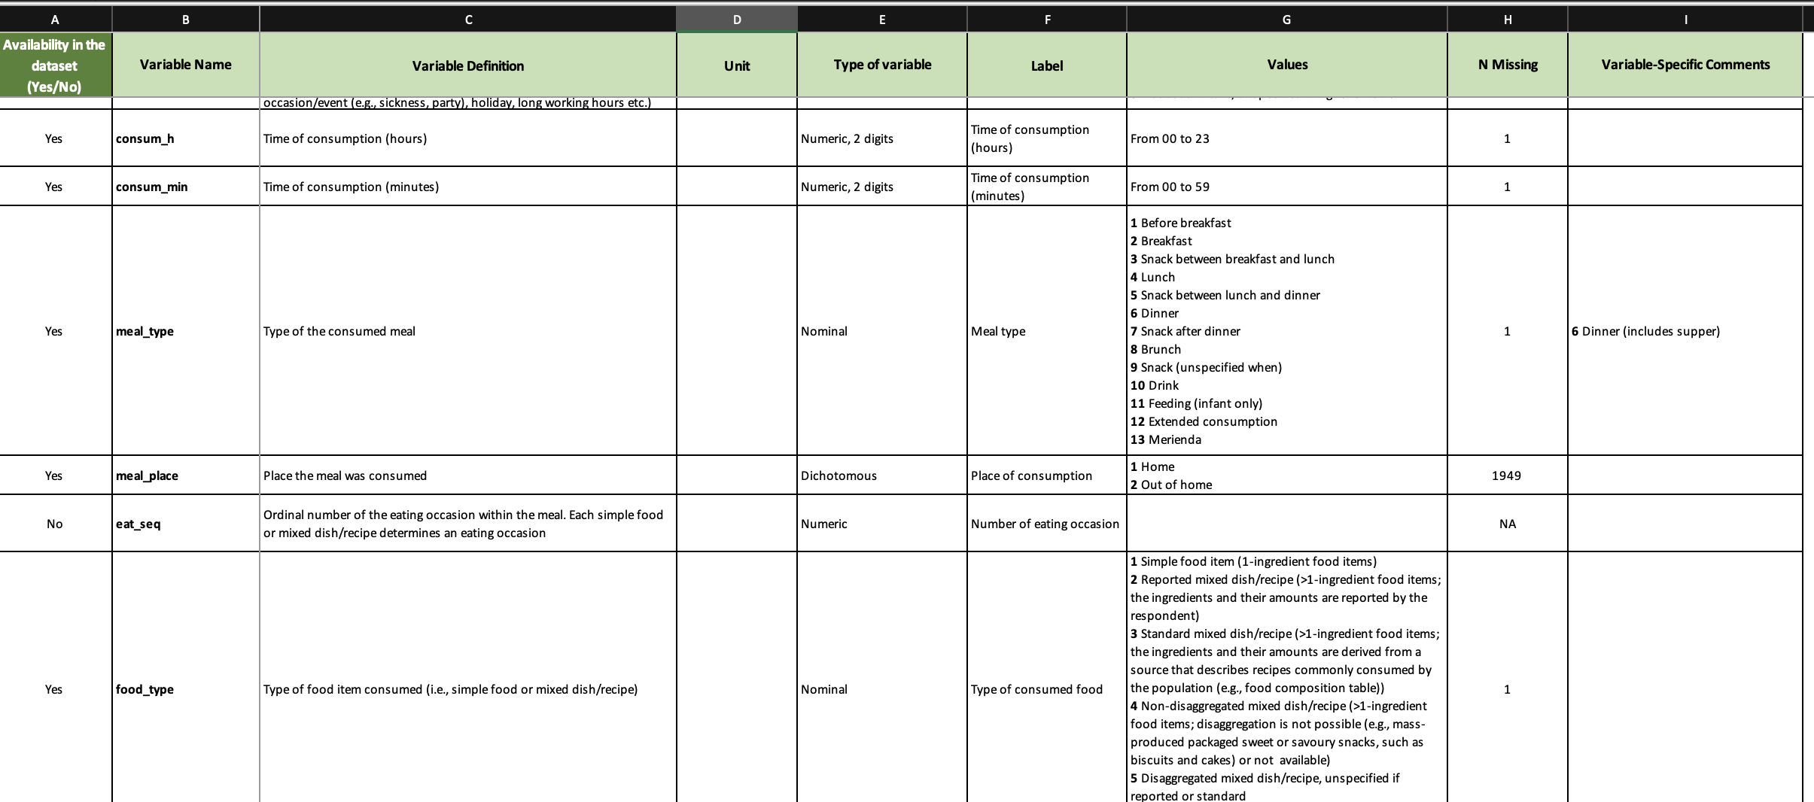
2. Lifestyle Recommender - Dataset
Notes:
The raw dataset is obtained from National Health and Nutrition Examination Survey Data (NHANES), 2015-2016; Centers for Disease Control and Prevention (CDC), National Center for Health Statistics (NCHS). Hyattsville, MD: U.S. Department of Health and Human Services, Centers for Disease Control and Prevention. Harmonized for the Global Dietary Database.
There are more than 8506 participants on this survey, but after the clean up only data from 5214 is suitable for the model due to various reason such as:
Empty data
The age group not suitable (the target audience only for age 18 and above)

Slide 12
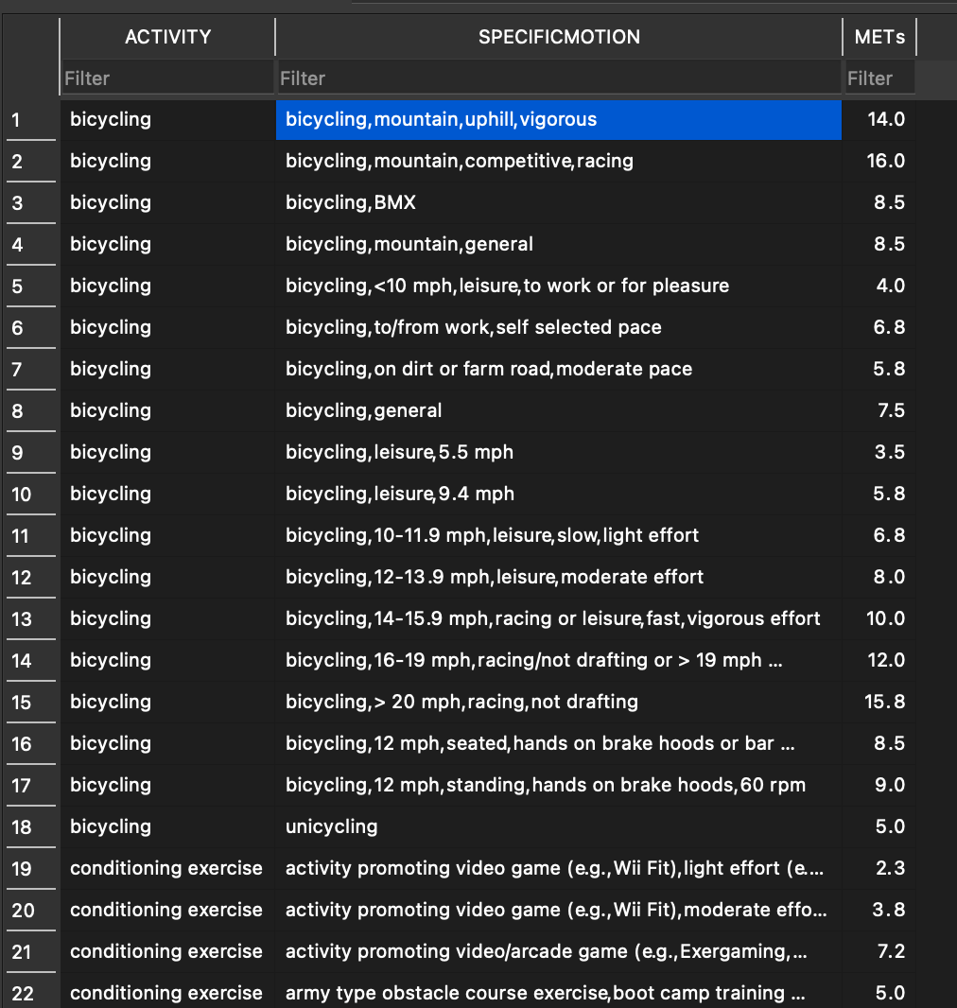
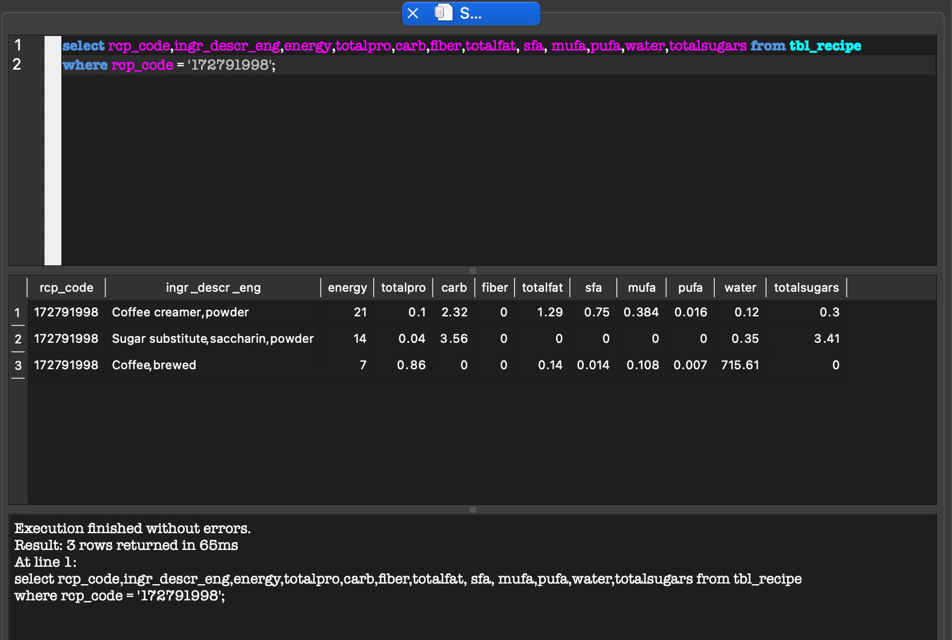
2. Lifestyle Recommender - Model
Notes:
The model that being used is to predict the increase or decrease of BMI based on the meal taken.
Each meal taken will have a properties such as energy, total carbohydrate, total sugar , total protein, cholesterol level and others.
All these properties and featured will be added and pass as input parameter for the model.
Apart from meal, system also will use the physical activities chosen to calculate and advice when it’s not ideal.
The ideal is being set as 500 – 1000 MET minutes per week.
The final result of the recommender will be:
Advice of meal
Advice on activity such as increase frequency, increase duration and/or do exercise with higher intensity.

Slide 13
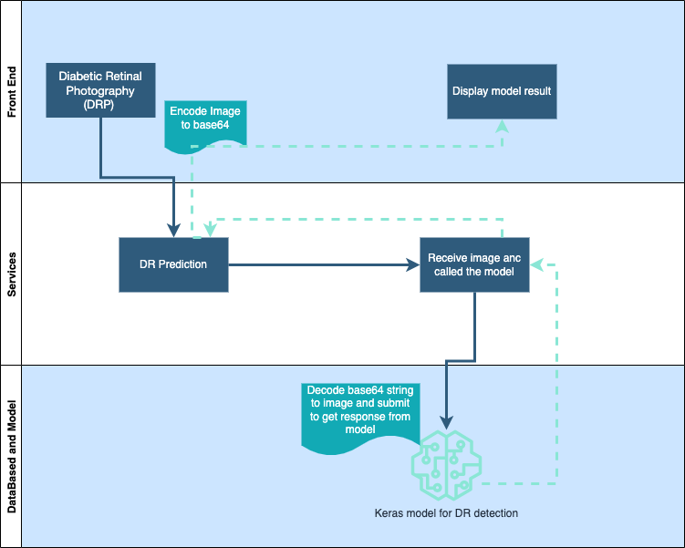
3. Detect Diabetic Retinopathy
Notes:
The last feature is Diabetic retinopathy level prediction.
This feature is meant for diabetic patient that is worry and like to check their eye’s health
When user select this menu, user will be asked to upload their eye picture.
Once uploaded, the image will be converted to base 64 format as the input to the services.
The service will convert the base 64 back to image as input to keras model to do the prediction.

Slide 14
3. Detect Diabetic Retinopathy - Dataset
https://www.kaggle.com/c/diabetic-retinopathy-detection
Notes:
We are using dataset from Kaggle.
There is at total of 37,070 high-resolution images.
A clinician has rated the presence of Diabetic Retinopathy (‘DR’) in each image on a scale of 0 to 4
we noticed that the data is imbalanced with 70% of the subject having no DR.
Building a model on imbalanced dataset may lead to a sub-optimal model with seemingly high accuracy.
To tackle the imbalanced dataset, we have performed stratified sampling, picking 200 subjects for each subgroup.
Before training the model, we have performed some pre-processing to resize the image to 224 x 224 and
to standardize the data to ensure that the RGB channel is in the [0, 1] range.

Slide 15
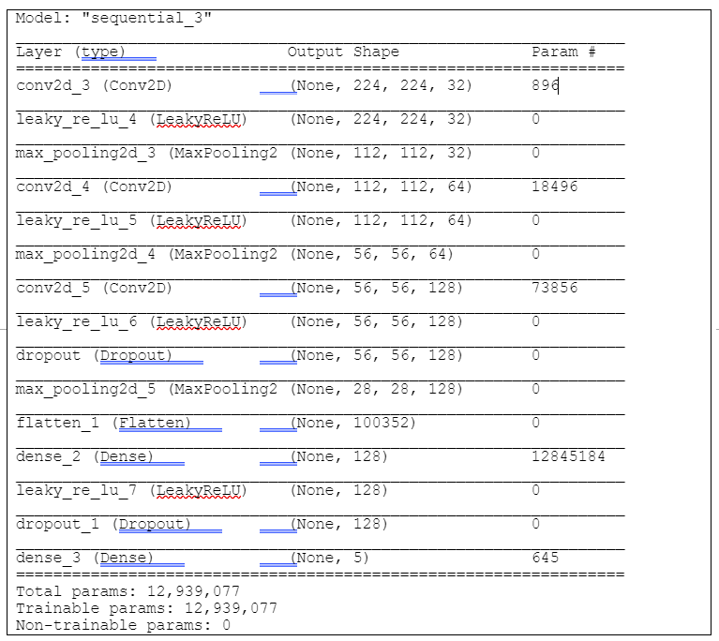
3. Detect Diabetic Retinopathy - Model
Using Keras
Tensorflow as backend
Notes:
This model is built using keras with tensorflow as the backend.
In this model, it is defined as sequence of layers in the network.
This network are dense, as output of each neuron is connected to all neuron in the following layer.
We first define the convolutional base using stack of Conv2D and MaxPooling2D layers.
We then activate it using LeakyReLu activation function.
Lastly to complete the model, we have flattened the last output tensor from the convolutional base into 2 Dense layer.
there is 5 output classes, so we have used a final Dense layer with 5 outputs.

Slide 16
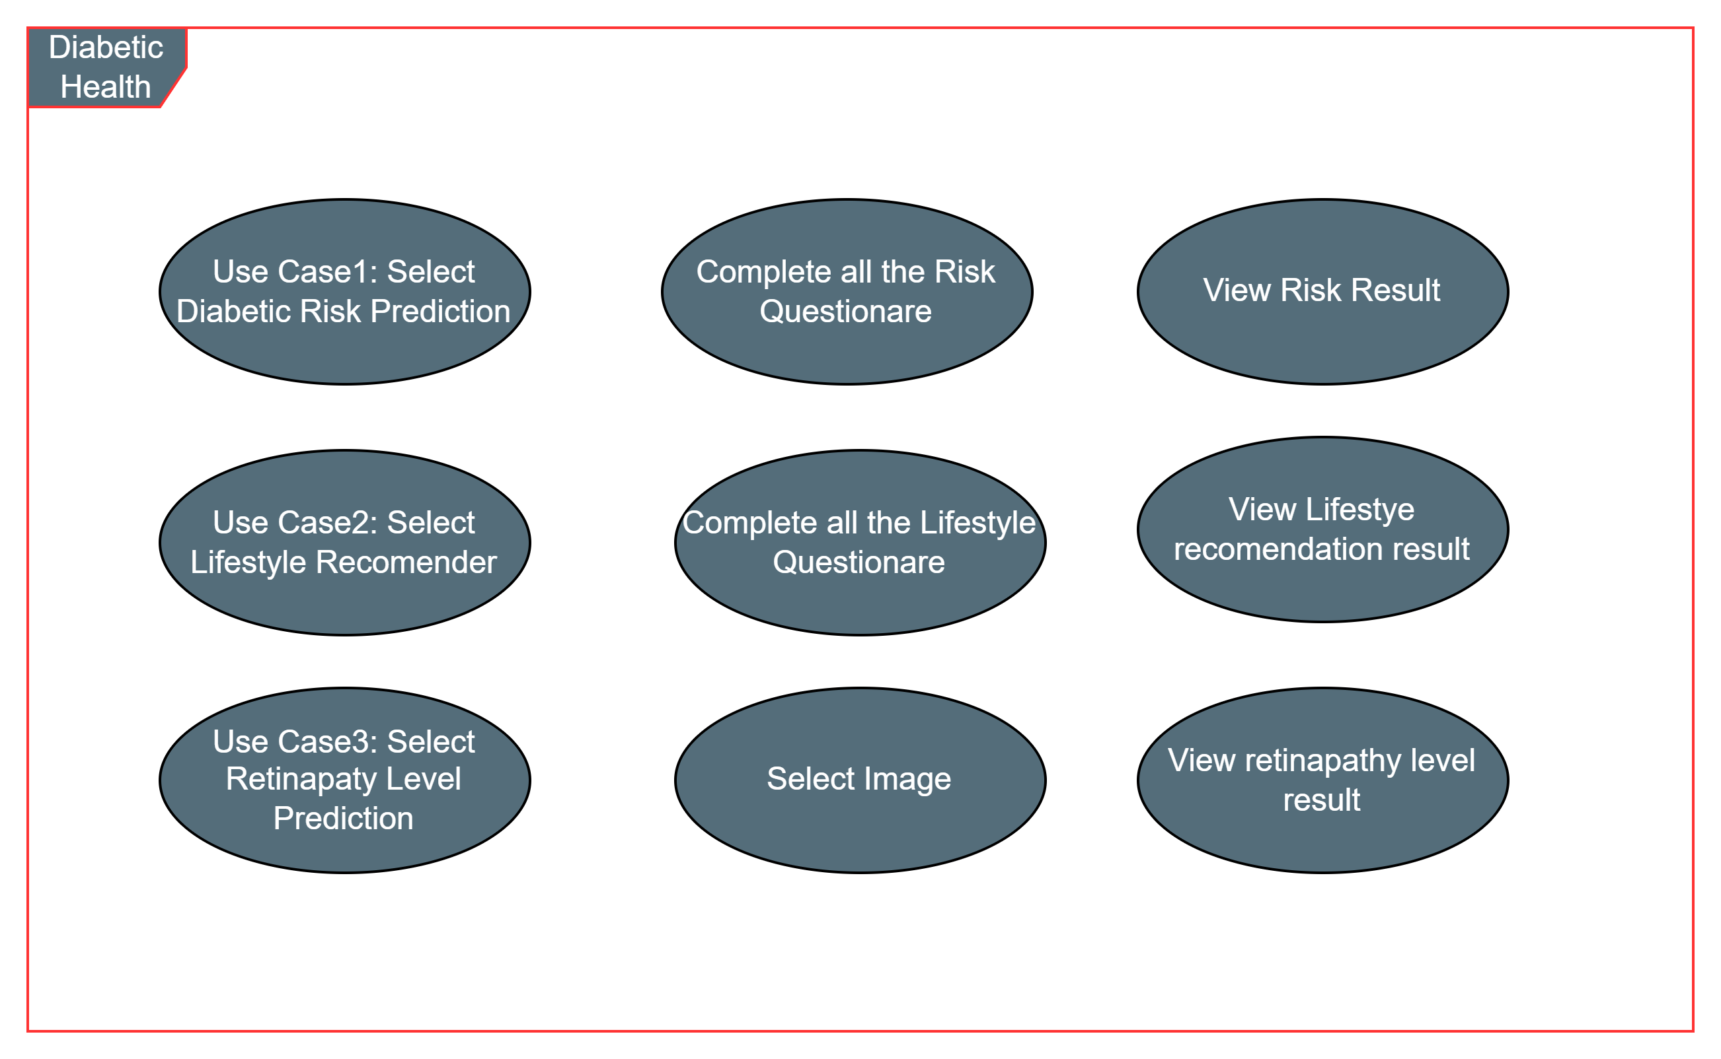

APP Use Case
<include>
<include>
<extend>
<include>
<include>
<include>
<include>
Notes:
This is the application use cases.
There is only one actor / user for the app
The user will initiate the app by open up the diabetic health app.
There are 3 main use case : select diabetic risk prediction, select lifestyle recommender and select retinopathy level prediction.
When use case 1 is selected, user have to complete set of questionnaire related to diabetic risk however if the user is already a diabetic patient, he / she will
Be asked to select use case 2 which is lifestyle recommender.
For both use case 1 and use case 2, user have to complete set of questionnaires in order to get the result
While for use case 3, once it is executed user have to upload the image to the app and then the app will predict the diabetic retinopathy level.

Slide 17
DEMO!
Notes:
That’s our technical presentation.
Lets continue with product demonstration.

Slide 18

Notes:
Welcome to Diabetes Health App.
Health at fingertips

Slide 19
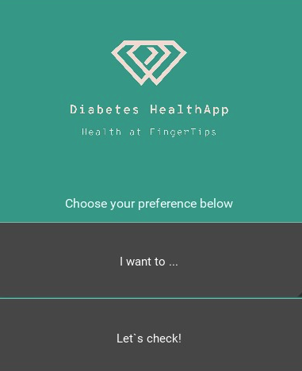
Notes:
I will be walking you through the app.
When starting the program, head over to the preference selection.

Slide 20
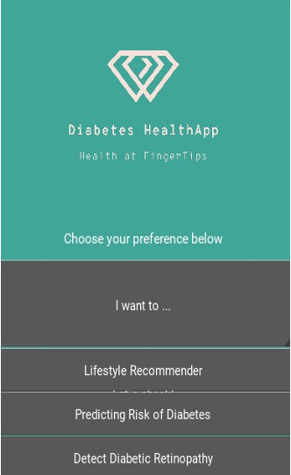
Notes:
Here you will find 3 selections.
Lifestyle recommender,
Predicting Risk of Diabetes and
Detect Diabetic Retinopathy.

Slide 21
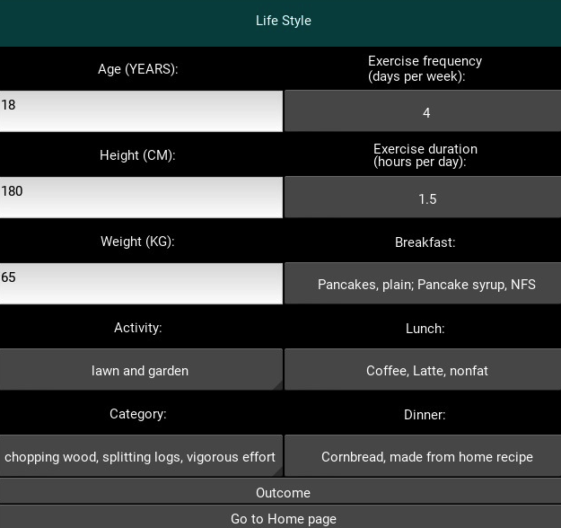
Notes:
Select Life style recommender.
New window will be opened.
The app will have few question for you.
Take your time to fill up all the answer to the question,
And tap the Outcome button once you complete the answer.
System will then generate the recommender report

Slide 22
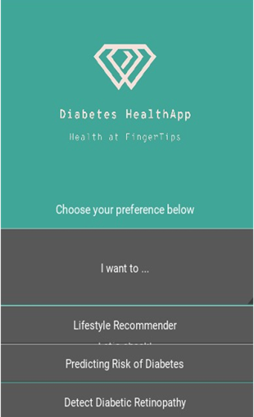
Notes:
Please review the recommender report.
Once done, head over back to Home page.
Tap on the predicting Risk of diabetes.
New windows with set of questions will be generated.
Please take your time to answer all the questions.
Click Lets Calculate and the system will generate the Risk level.

Slide 23
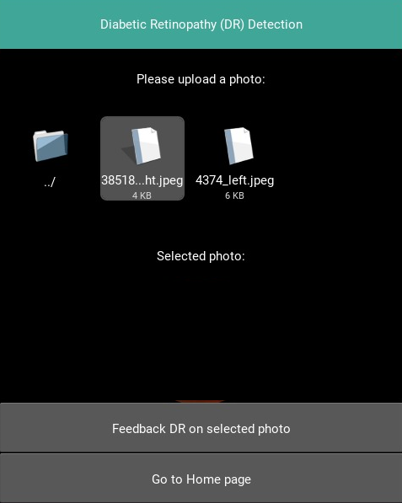
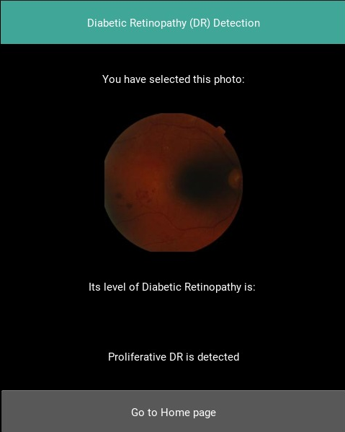
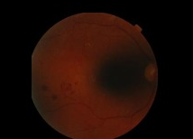
Notes:
Please head back to home page for diabetic Retinopathy check.
Tap on the Detect Diabetic Retinopathy option.
New screen will be open. Browse and select the image file that you want to check.

Slide 24
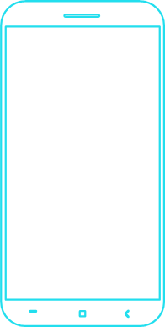
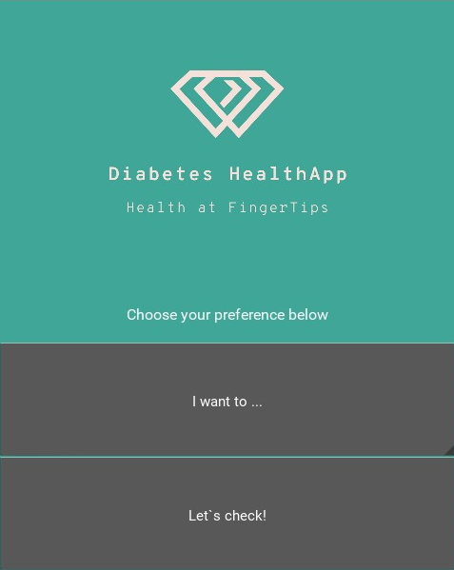
Email:
e0938644@u.nus.edu
e0938899@u.nus.edu
e0938856@u.nus.edu
e0938623@u.nus.edu
e0938863@.u.nus.edu
Notes:
For further questions please contact our email.
Thank You.

